Slide 1

COVID19

Slide 2
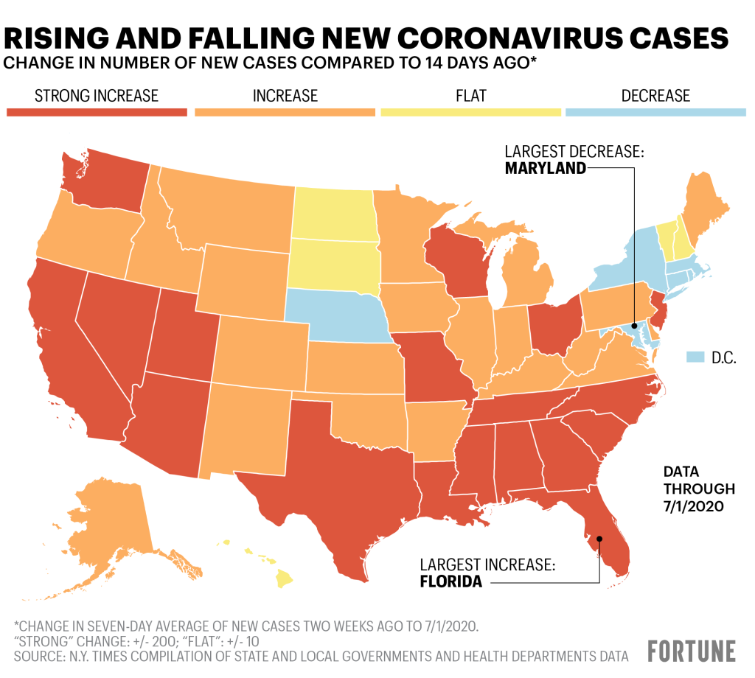

Slide 3


Do rates of covid19 differ based on local policies implemented?
Comparison between California and Texas

Slide 4
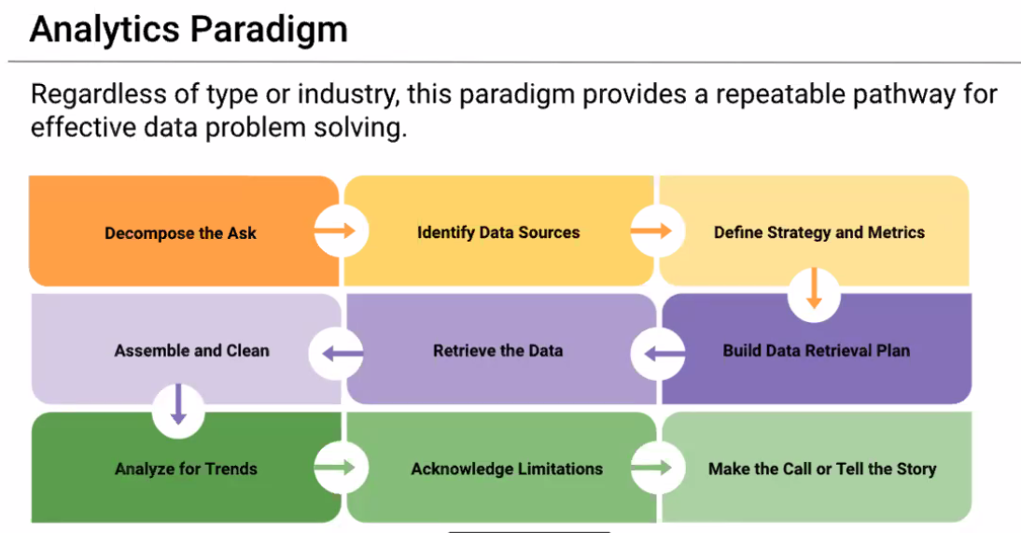

Slide 5
Resources
John Hopkins University Covid19 data
NY Times
CA and TX Health Government websites (policy implementation)

Slide 6
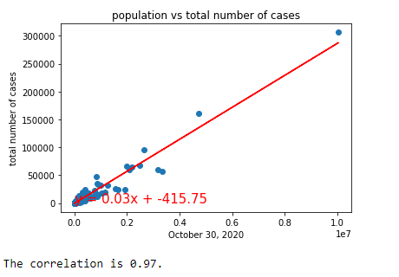
Exploratory data visualization
CA and TX population plotted together against cumulative Covid19 cases by 10/30/2020

Slide 7
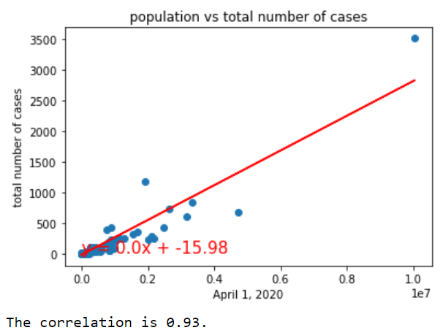
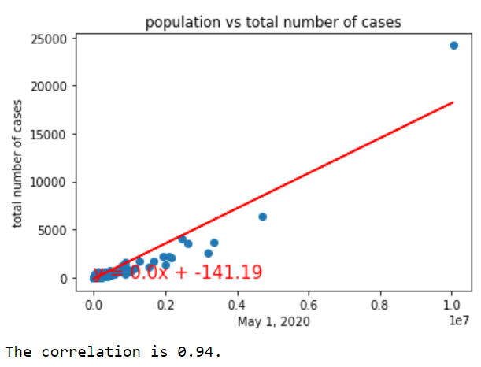
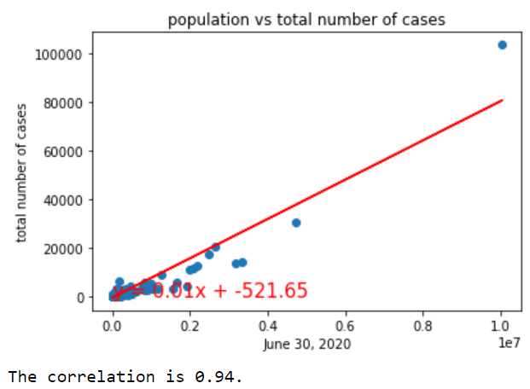
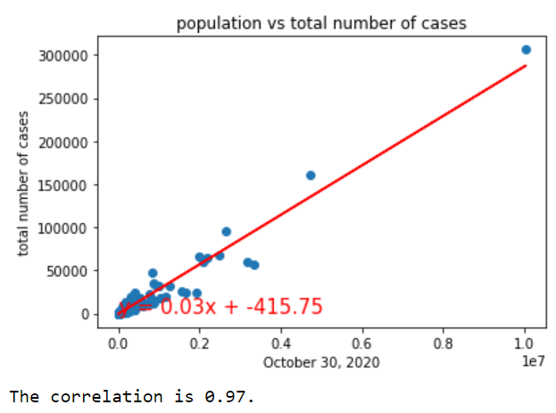
CA and TX population plotted together against cumulative Covid19 cases by Dates
April 1,2020
May 1,2020
June 30,2020
October 30,2020

Slide 8
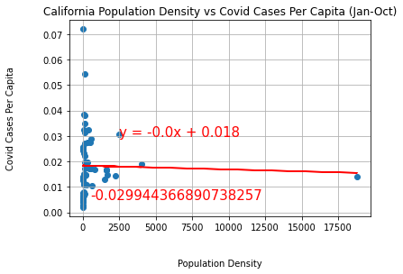
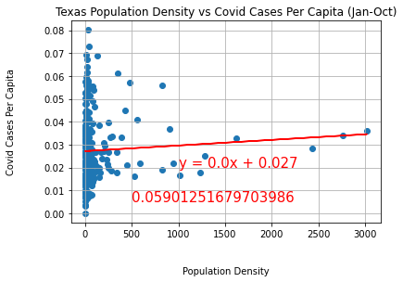
State | Population | Diff in population | Land Area(Sq. Mi.) | Diff in Land Area
CA | 37,332,138 | CA 8.3 million more | 155,779 | TX 105K Sq. Mi. more
TX | 28,995,881 |  | 261,267
San Francisco

Slide 9
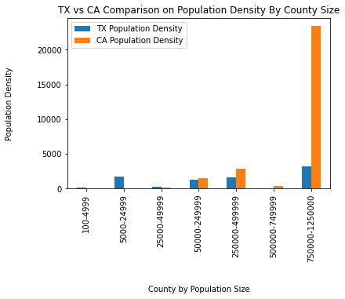
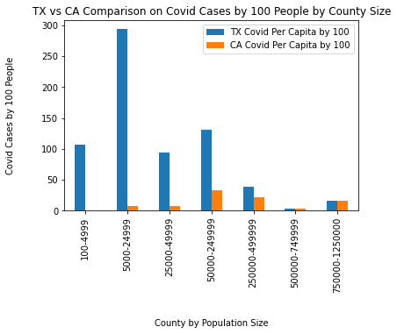
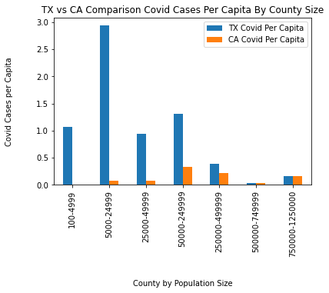
Counties by Population Size

Slide 10
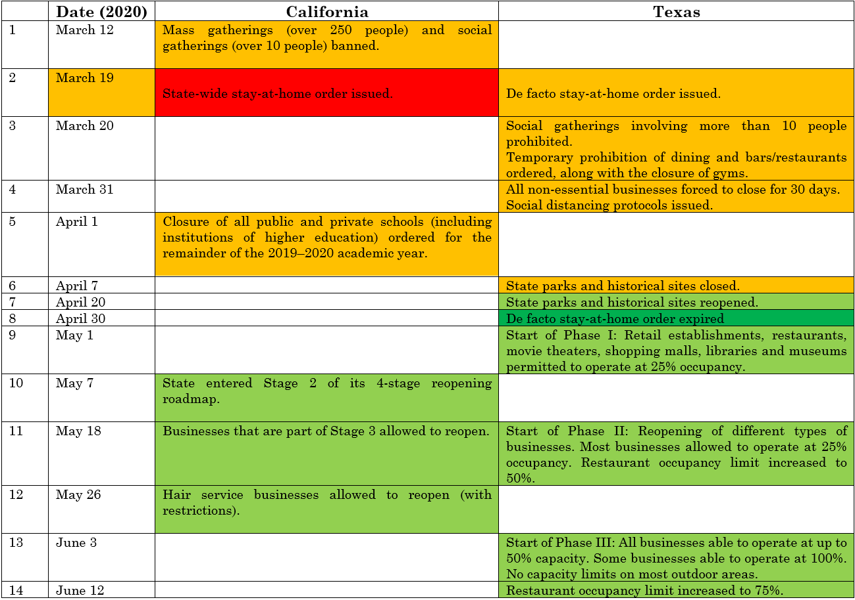

Slide 11
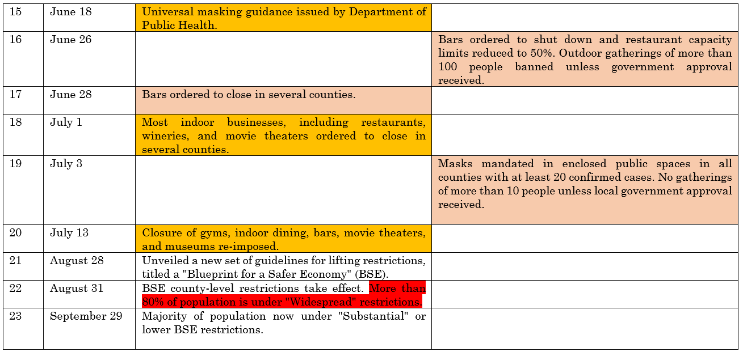

Slide 12
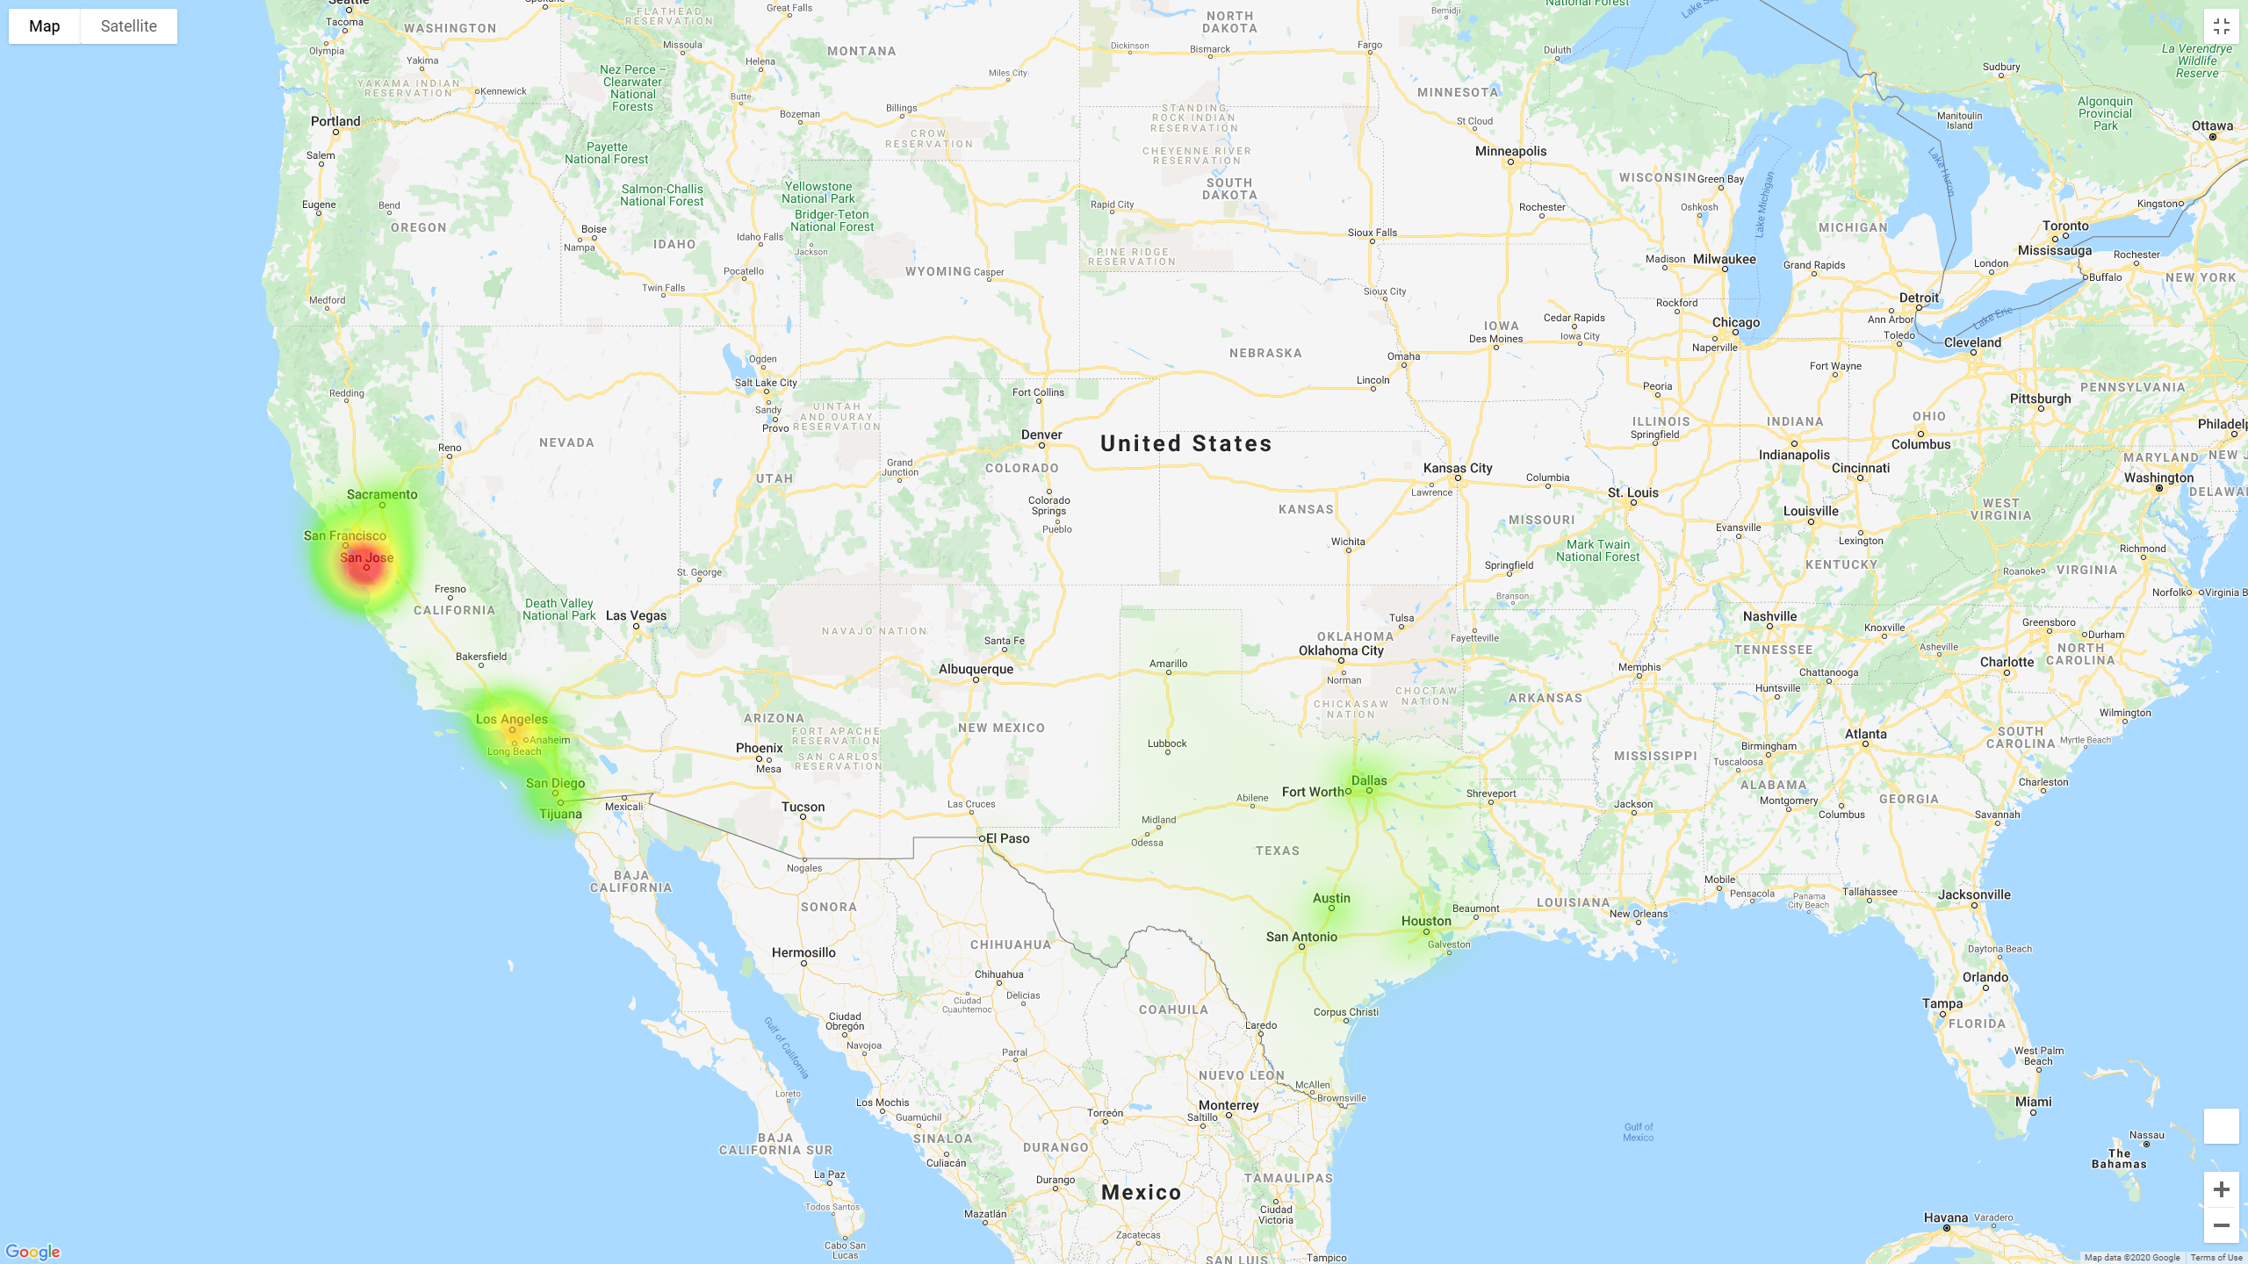

Slide 13
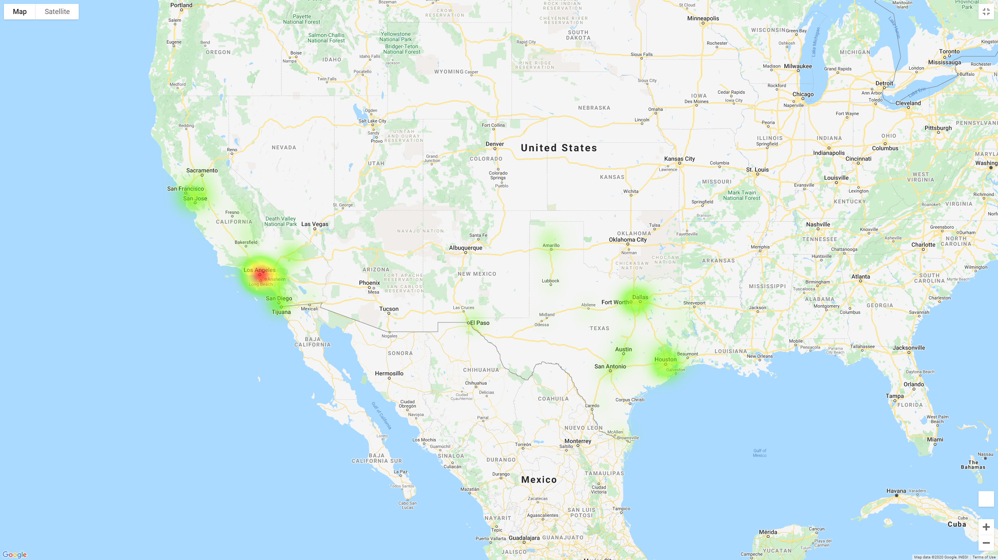

Slide 14
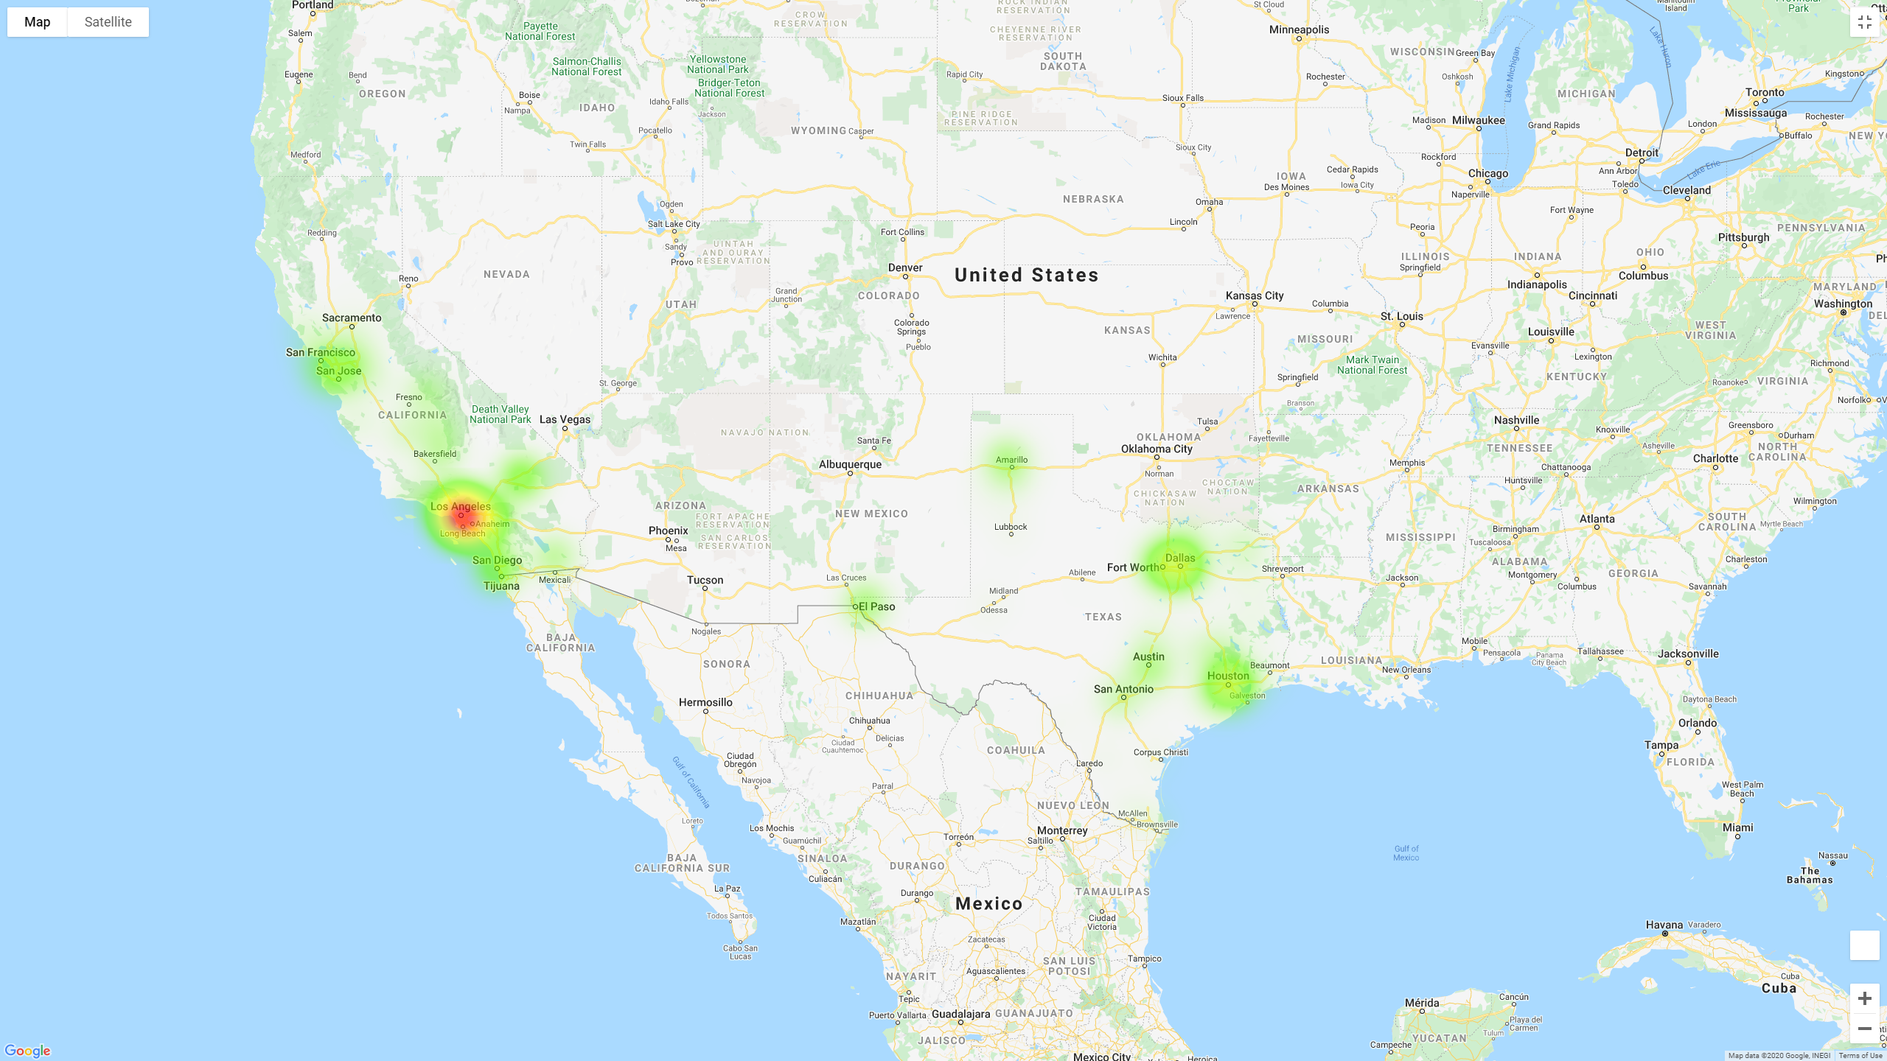

Slide 15
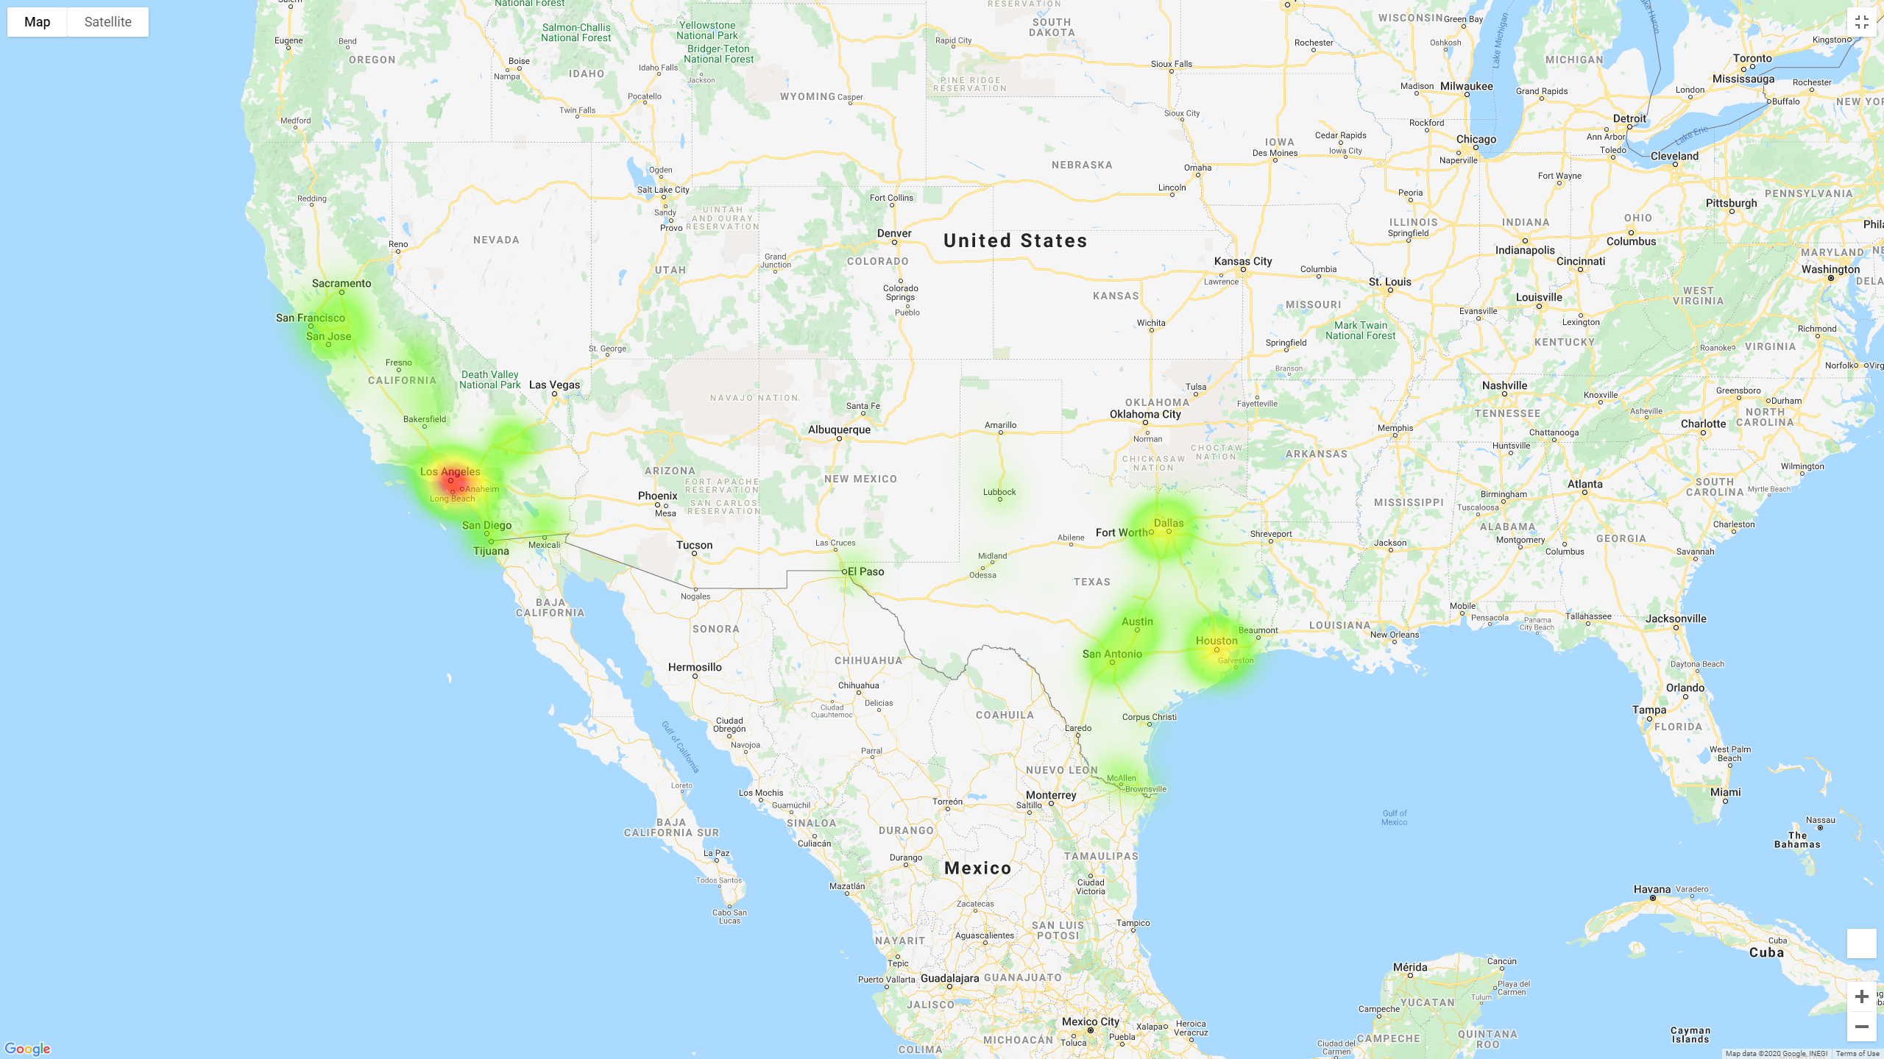

Slide 16
